Slide 1
WW2 Time Line

Slide 2
7 July 1937
Clash near the Marco Polo Bridge, close to Beijing
Start of Sino-Japanese War

Slide 3
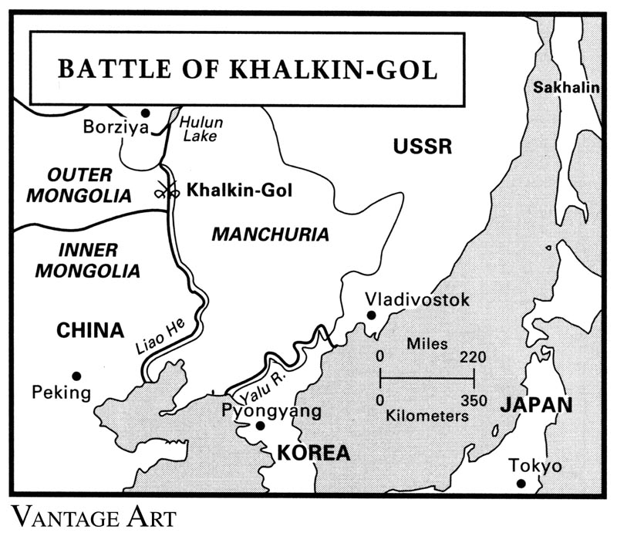
11 May – 16 September 1939
Battles of Khalkhin Gol
Border skirmishes since 1932
Japanese now turn southward for resources.

Slide 4
anschluss

Slide 5
Munich agreement

Slide 6
Germany takes rest of Czecholslovakia

Slide 7
1 September 1939
Germany invades Poland
Soviet Union invades 17 September 1939

Slide 8
10 May 1940
Germans launch offensive in the West
Belgium, Netherlands, & France

Slide 9
12 August 1940
Battle of Britain begins

Slide 10
22 June 1941
Launching of Operation Barbarossa

Slide 11
7 December 1941
Attack on Pearl Harbor

Slide 12
7 December 1941
Attack on Pearl Harbor

Slide 13
8 December 1941
Japanese invade Philippines

Slide 14
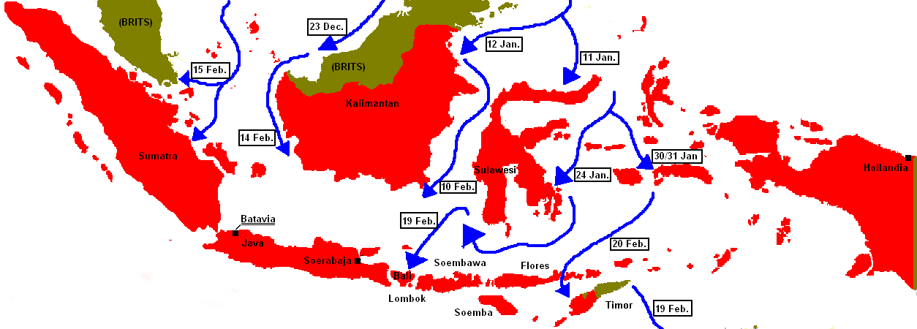
23 December – 19 February 1941-1942
Japanese invade the Dutch East Indies (Indonesia)

Slide 15
4 June 1942
Battle of Midway

Slide 16
23 August 1942 – 2 February 1943
Battle of Stalingrad
Turning Point on the Eastern Front

Slide 17
7 August 1942 - 9 February 1943
Guadalcanal Campaign

Slide 18
5 July 1943:
Germans launch battle of Kursk
Last German offensive in the East

Slide 19
6 June 1944:
D-Day

Slide 20
23 - 26 October 1944
Battle of Leyte Gulf

Slide 21
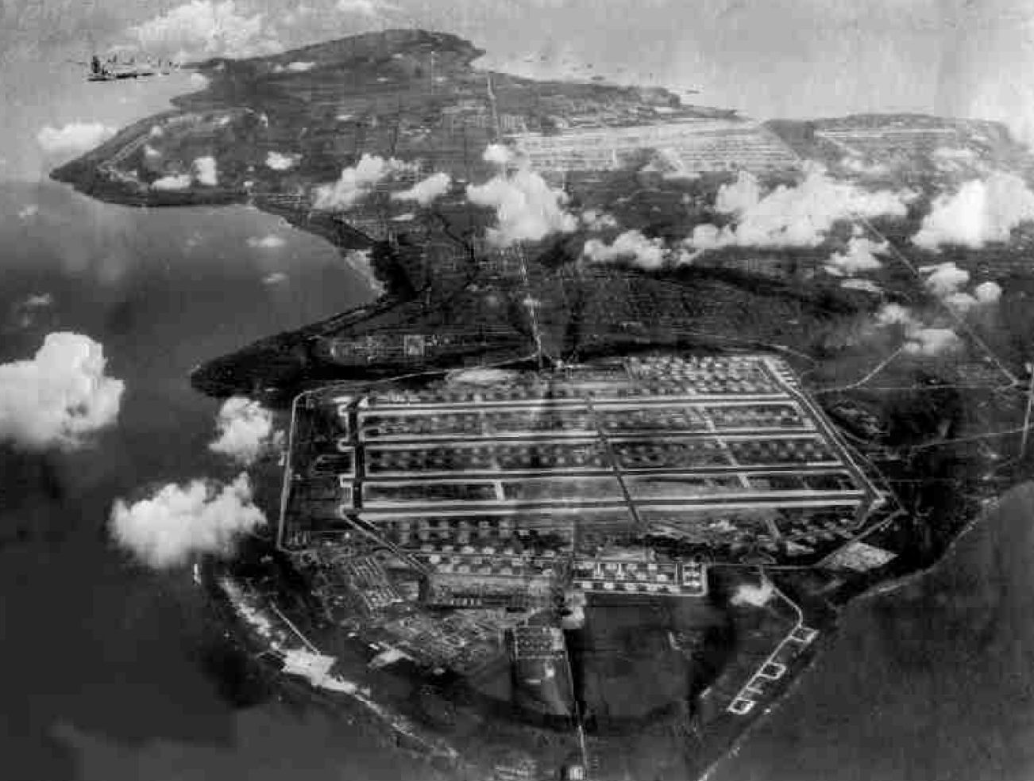
24 July - 1 August 1944
Battle of Tinian

Slide 22
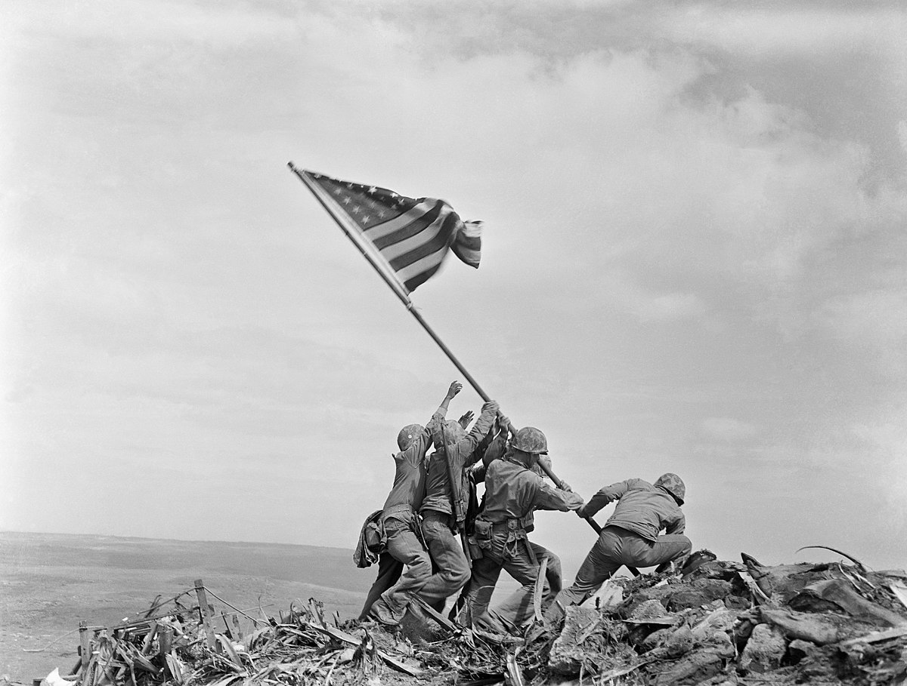
19 February – 26 March 1945
Battle of Iwo Jima

Slide 23
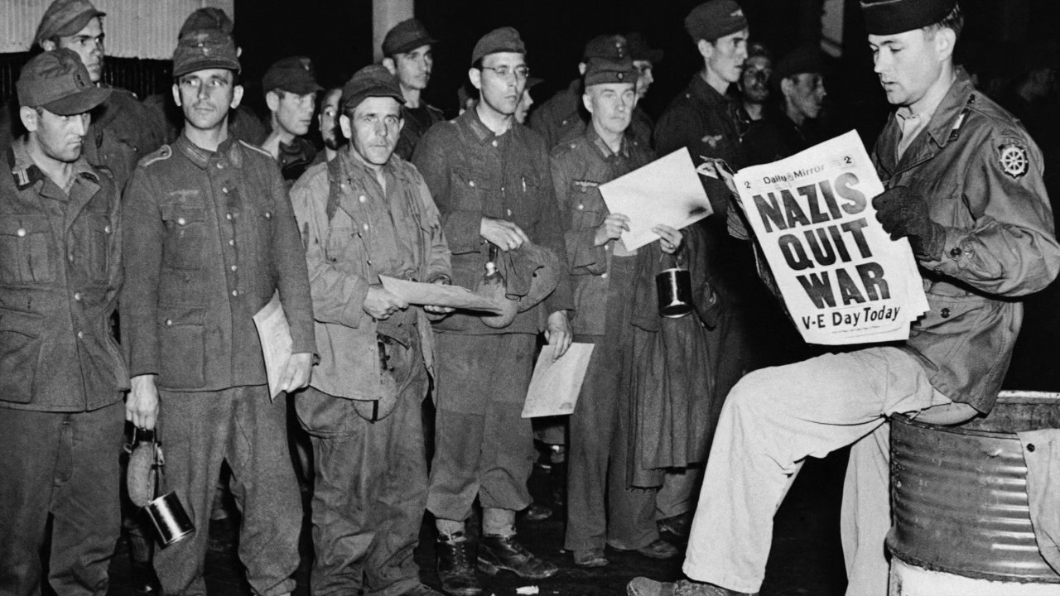
8 May1945
VE Day

Slide 24
9 August 1945
Dropping of second atom bomb, on Nagasaki
Why? Hiroshima

Slide 25
August 9 – September 3, 1945
Soviet-Japanese War

Slide 26
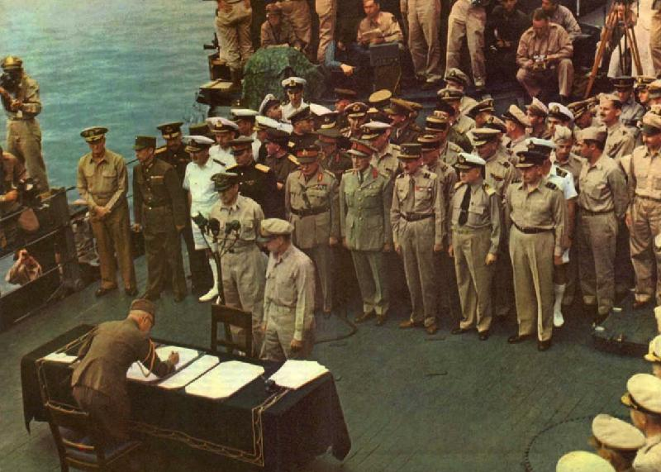
2 September 1945
VJ Day

Slide 27
Winners?
Courtney Cox - candy corn - coca-cola – captain crunch – cape cod – captain chaos – colonel condiment – crunchy crayons -
Charlie Chaplin – chesire cat – crusty charmin – crappy car -
Cotton Candy
Crispy Chicken
Candy Cane
Cookie Crumbs
Coconut Crème
Chuckie Cheese

